Slide 1
Chongqing University of Technology
ATAI
Advanced Technique of Artificial Intelligence
Chongqing University of Technology
Two are Better than One:
Joint Entity and Relation Extraction with Table-Sequence Encoders
Jue Wang1and Wei Lu2
1College of Computer Science and Technology, Zhejiang University
2StatNLP Research Group, Singapore University of Technology and Design
Speaker: ZhangLiang
2021.03.28
EMNLP 2020

Slide 2
Content
01
Introduction
02
Related Work
03
Model
04
Experiments

Slide 3
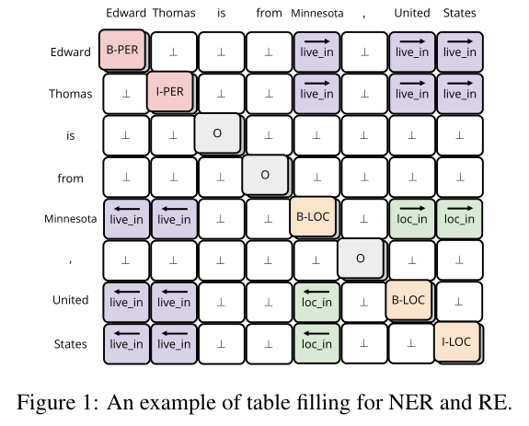
Introduction
Method before：Table Filling
feature confusion as they use a single representation for the two tasks
underutilize the table structure as they usually convert it to a sequence and then use a sequence labeling approach to fill the table

Slide 4
Introduction
Work for this paper:
• Propose to learn two separate encoders – a table encoder and a sequence encoder. They interact with each other, and can capture task-specific information for the NER and RE tasks;
• Propose to use multidimensional recurrent neural networks to better exploit the structural information of the table representation;
• Leverage the word-word interaction information carried in the attention weights from BERT, which further improves the performance.

Slide 5
Related Work
Models include kernel methods (Ze-lenko et al., 2002), RNNs (Zhang and Wang, 2015), recursive neural networks (Socher et al., 2012), CNNs (Zeng et al., 2014), and Transformer models(V erga et al., 2018; Wang et al., 2019).
Miwa and Bansal (2016) use bi-LSTM (Graves et al., 2013) and tree-LSTM (Tai et al., 2015) for the joint task. Miwa and Sasaki (2014) tackle joint NER and RE as from a table filling perspective, where the entry at row i and column j of the table corresponds to the pair of i-th and j-th word of the input sentence.
Recent work (Luan et al., 2019; Dixit and Al, 2019; Wadden et al., 2019; Li et al., 2019; Eberts and Ulges, 2019) usually leverages pre-trained language models such as ELMo (Peters et al., 2018),BERT (Devlin et al., 2019), RoBERTa (Liu et al., 2019), and ALBERT (Lan et al., 2019). However, none of them use pre-trained attention weights.

Slide 6
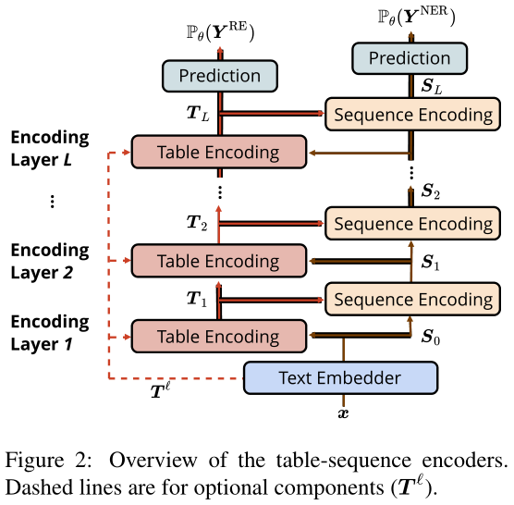
Model

Slide 7
Approach
Text Embedder：

Slide 8
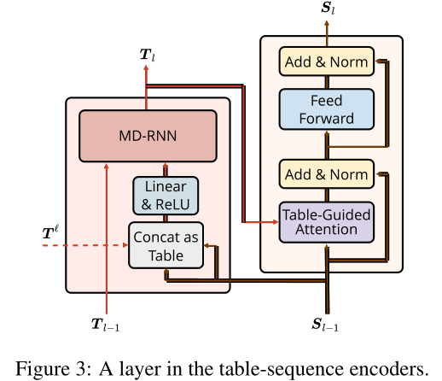
Approach
Table Encoder：

Slide 9
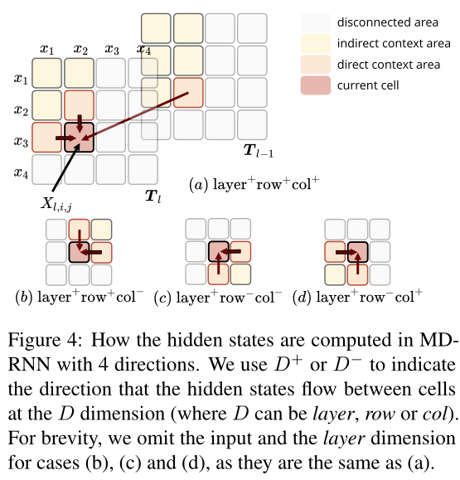
Approach

Slide 10
Approach
Sequence Encoder：

Slide 11
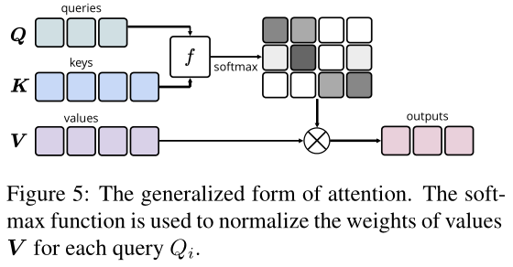
Approach

Slide 12
Approach
Exploit Pre-trained Attention Weights：

Slide 13
Approach
Training and Evaluation：

Slide 14
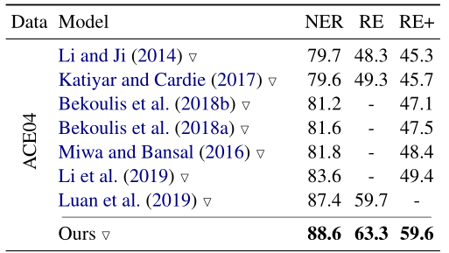
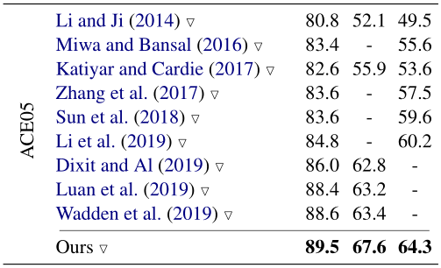
Experiments

Slide 15
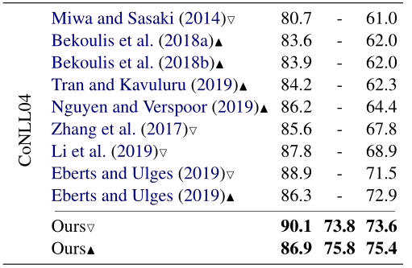
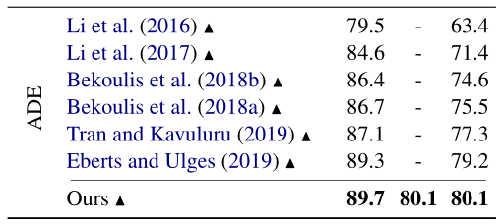
Experiments

Slide 16
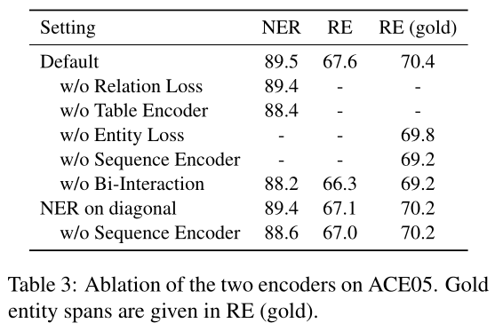
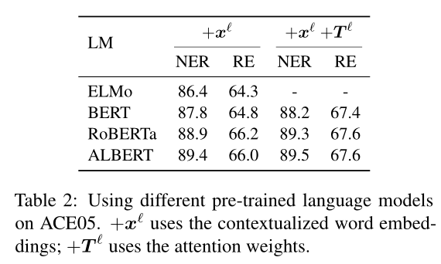
Experiments

Slide 17
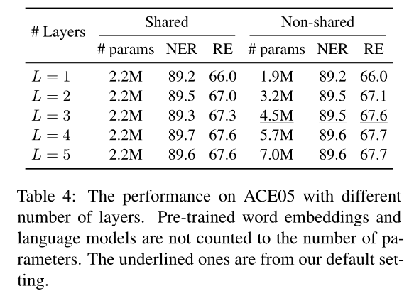
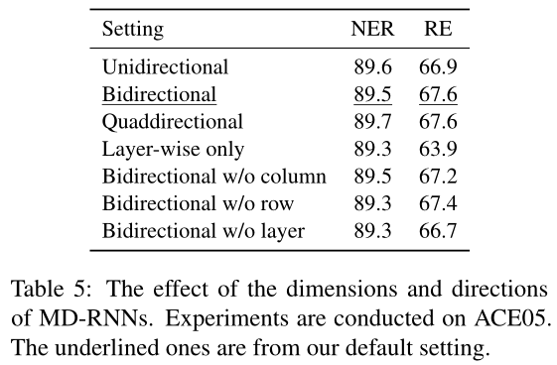
Experiments

Slide 18
Thanks

